Slide 1
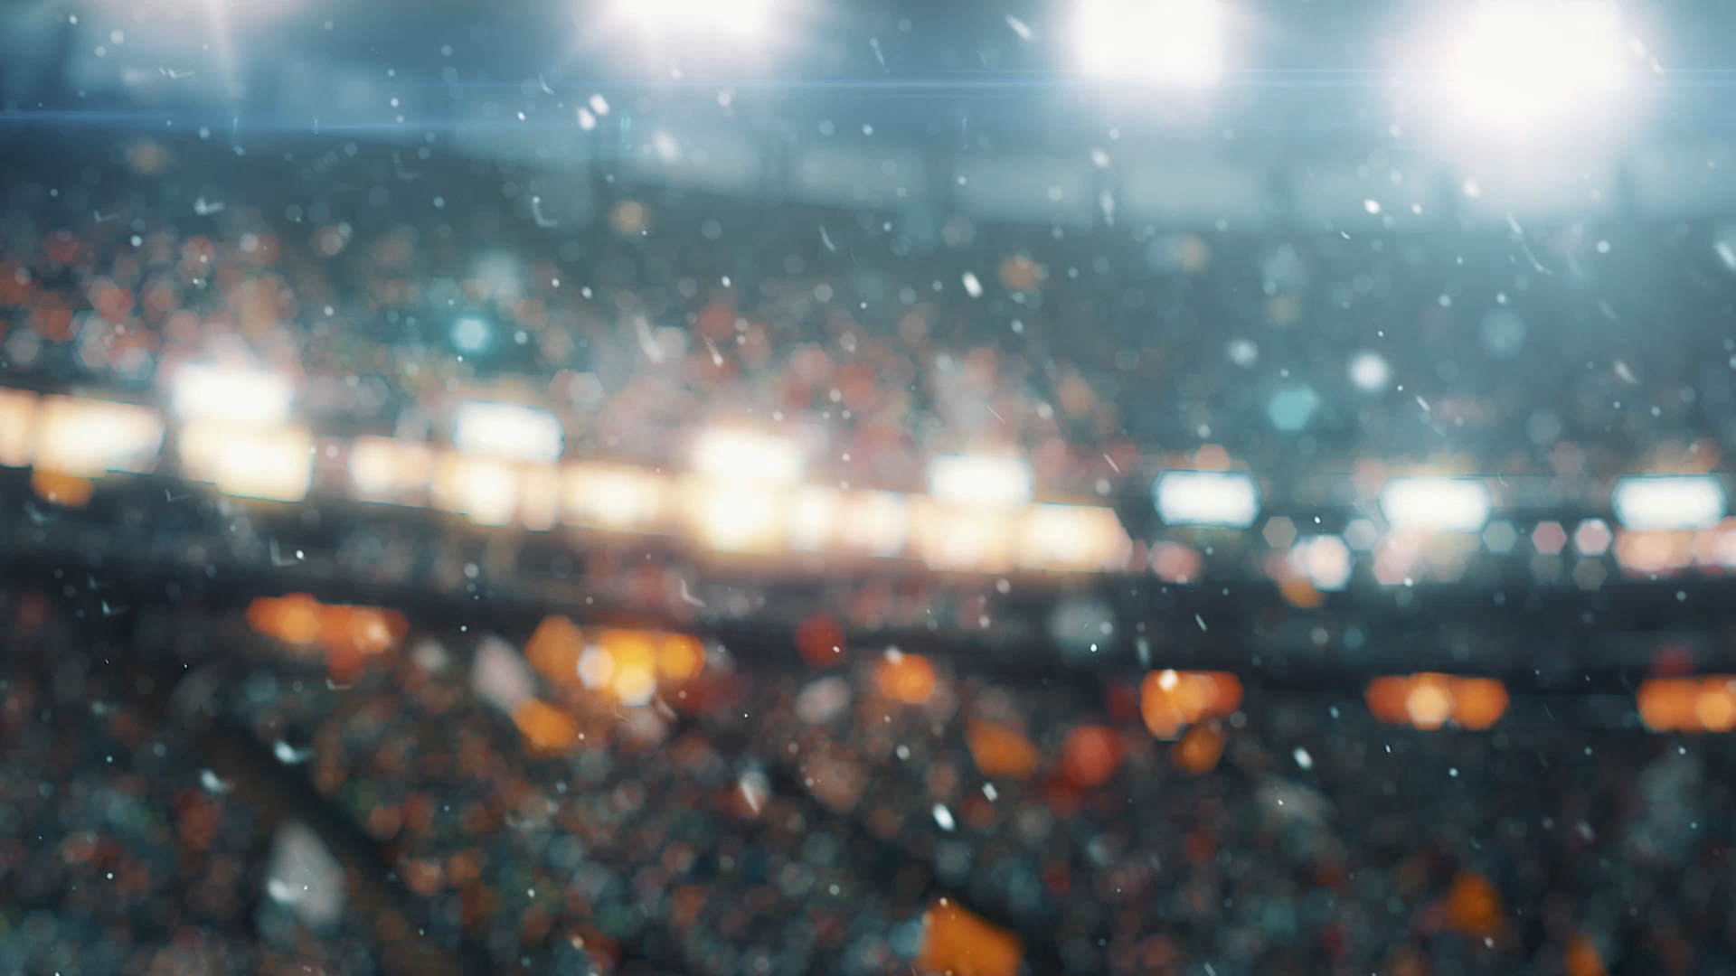

Super Bowl Predictor
Isabella Sturm
DSC 680

Slide 2
Business Problem
NFL is a business – money is involved in the Super Bowl
Teams want to know what factors impact their chances of making it to the Super Bowl
Fans want to know if their team will make it –perhaps even place bets

Slide 3
Background
First Super Bowl
1966
Game between top team in the NFL and the AFL (two separate leagues at the time)
NFL and AFL merged in 1970 – Super Bowl continued with big game between top two teams in the league
Super Bowl viewership is not really affected by which teams are actually playing

Slide 4
Data
Sources
NFL.com – 1970-2021
Offensive Stats
Passing
Rushing
Receiving
Scoring
Downs
Defensive Stats
Passing
Rushing
Receiving
Scoring
Tackles
Downs
Fumbles
Interceptions
pro-football-reference.com – 1976-2021
Schedule & Game Results

Slide 5
Data Steps
NFL – Read data in from site, pulling each stat for each team per year PFR – Read in each team schedule for each year, added Super Bowl target column
Had to rename Team columns to match between the two datasets
NFL data used historic team names based on year, had to rename to match PFR (used current name for all years)
Removed columns deemed unneeded in both datasets
Summarized PFR data
Merged datasets on Team and Year columns
Ensured all columns were numeric – encoded Team name
Resulting Dataset: 104 columns and 1381 rows

Slide 6
Exploratory Analysis - Steps
Used SelectKBest to choose the top 30 features in dataset
Split data for exploration into Super Bowl records and non-Super Bowl records
Created some histograms and bar charts of data
Plotted correlation matrix of top features

Slide 7
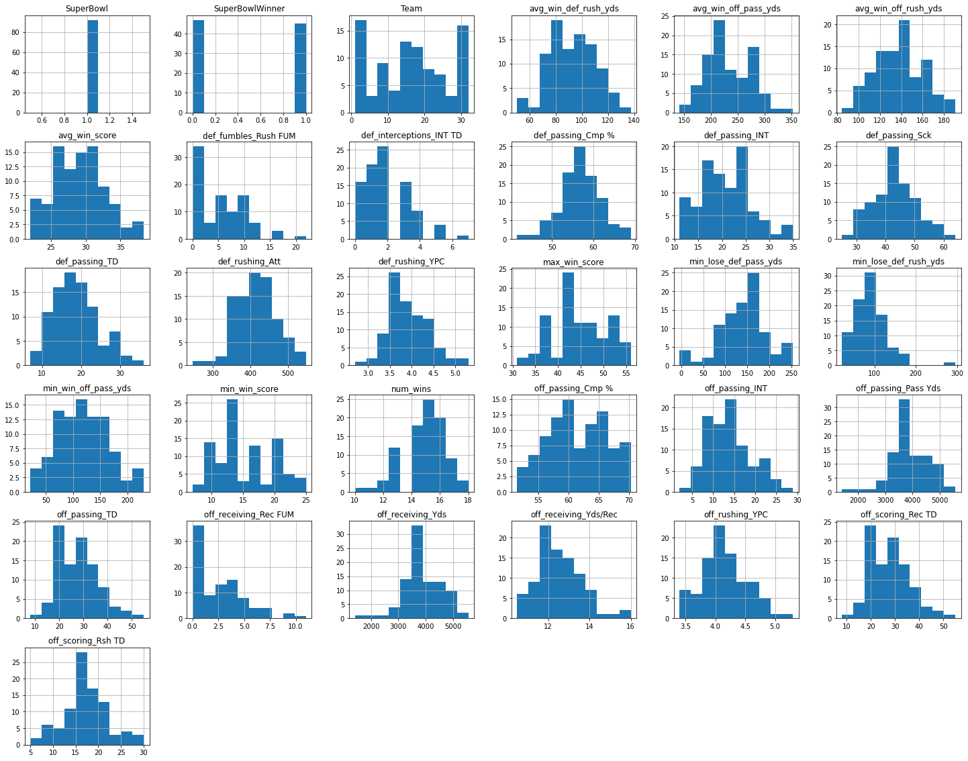
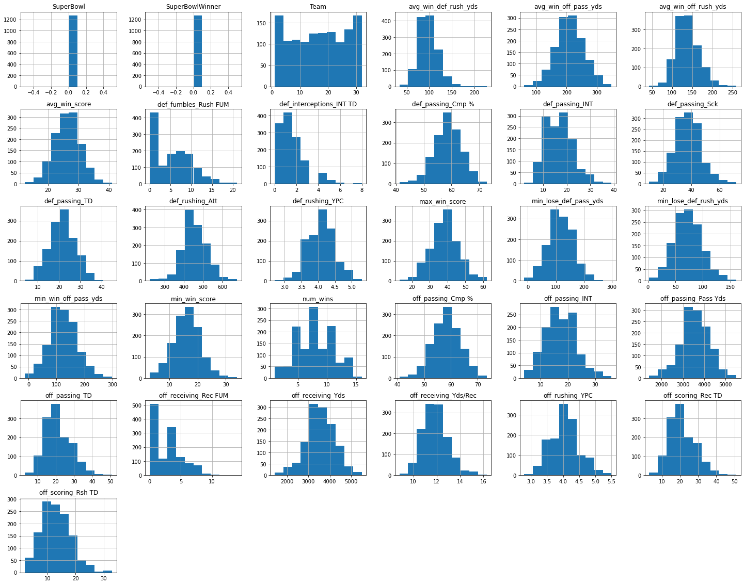
Exploratory Analysis – Features

Slide 8
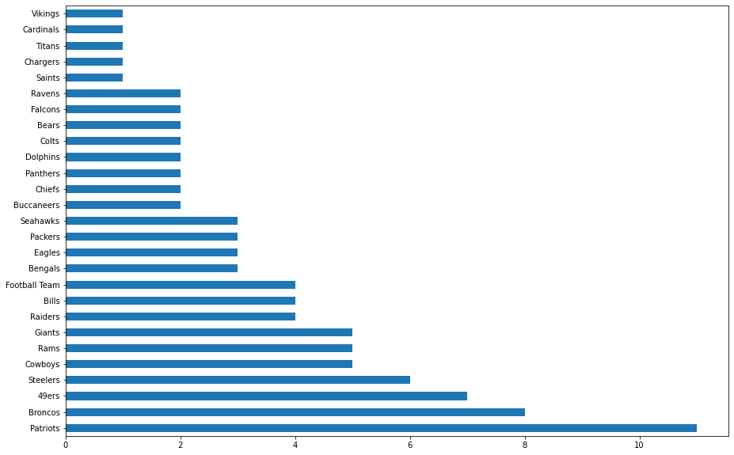
Exploratory Analysis - Super Bowl Teams

Slide 9
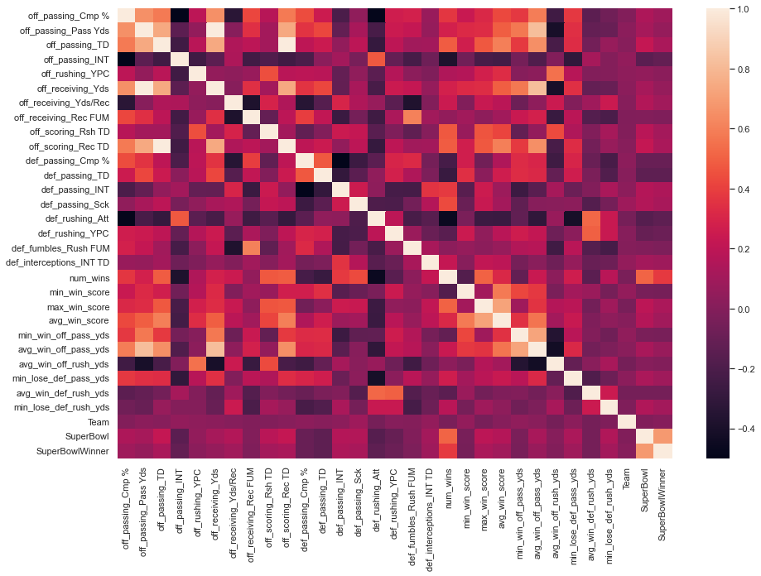
Exploratory Analysis – Correlation Matrix

Slide 10
Model Analysis
Data was scaled using StandardScaler then fit to the models
Support Vector Machines
94.026% accuracy
Logistic Regression
95.796% accuracy
Random Forest
96.681% accuracy

Slide 11
SVM Super Bowl LVI Predictions
Team | Prediction | Score | Probability_False | Probability_True
Rams | 0 | 0 | 0.137367 | 0.862633
Bengals | 0 | 0 | 0.606978 | 0.393022
Cowboys | 0 | 1 | 0.815357 | 0.184643
Buccaneers | 0 | 1 | 0.85498 | 0.14502
49ers | 0 | 1 | 0.94965 | 0.05035
Bills | 0 | 1 | 0.949708 | 0.050292
Raiders | 0 | 1 | 0.949734 | 0.050266
Chiefs | 0 | 1 | 0.957197 | 0.042803
Packers | 0 | 1 | 0.966025 | 0.033975
Titans | 0 | 1 | 0.968072 | 0.031928
Falcons | 0 | 1 | 0.974661 | 0.025339
Patriots | 0 | 1 | 0.976233 | 0.023767
Chargers | 0 | 1 | 0.977285 | 0.022715
Jaguars | 0 | 1 | 0.987106 | 0.012894
Eagles | 0 | 1 | 0.988964 | 0.011036
Steelers | 0 | 1 | 0.989526 | 0.010474
Cardinals | 0 | 1 | 0.991595 | 0.008405
Seahawks | 0 | 1 | 0.992942 | 0.007058
Lions | 0 | 1 | 0.993341 | 0.006659
Ravens | 0 | 1 | 0.994035 | 0.005965
Jets | 0 | 1 | 0.994364 | 0.005636
Giants | 0 | 1 | 0.994835 | 0.005165
Saints | 0 | 1 | 0.994989 | 0.005011
Colts | 0 | 1 | 0.995064 | 0.004936
Panthers | 0 | 1 | 0.996558 | 0.003442
Bears | 0 | 1 | 0.996669 | 0.003331
Vikings | 0 | 1 | 0.996775 | 0.003225
Football Team | 0 | 1 | 0.997838 | 0.002162
Texans | 0 | 1 | 0.998011 | 0.001989
Dolphins | 0 | 1 | 0.998583 | 0.001417
Browns | 0 | 1 | 0.999193 | 0.000807
Broncos | 0 | 1 | 0.99973 | 0.00027

Slide 12
Logistic Regression Super Bowl LVI Predictions
Team | Prediction | Score | Probability_False | Probability_True
Rams | 1 | 1 | 0.21602 | 0.78398
Buccaneers | 0 | 1 | 0.77397 | 0.22603
Chiefs | 0 | 1 | 0.84532 | 0.15468
Bengals | 0 | 0 | 0.90277 | 0.09723
Cowboys | 0 | 1 | 0.92483 | 0.07517
Bills | 0 | 1 | 0.94581 | 0.05419
Packers | 0 | 1 | 0.97687 | 0.02313
Titans | 0 | 1 | 0.97707 | 0.02293
Raiders | 0 | 1 | 0.98277 | 0.01723
49ers | 0 | 1 | 0.99191 | 0.00809
Cardinals | 0 | 1 | 0.99458 | 0.00542
Patriots | 0 | 1 | 0.99745 | 0.00255
Eagles | 0 | 1 | 0.99782 | 0.00218
Chargers | 0 | 1 | 0.99842 | 0.00158
Saints | 0 | 1 | 0.99908 | 0.00092
Dolphins | 0 | 1 | 0.99929 | 0.00071
Ravens | 0 | 1 | 0.99964 | 0.00036
Falcons | 0 | 1 | 0.99969 | 0.00031
Colts | 0 | 1 | 0.99971 | 0.00029
Steelers | 0 | 1 | 0.99972 | 0.00028
Vikings | 0 | 1 | 0.99978 | 0.00022
Seahawks | 0 | 1 | 0.99978 | 0.00022
Broncos | 0 | 1 | 0.99988 | 0.00012
Football Team | 0 | 1 | 0.99993 | 0.00007
Browns | 0 | 1 | 0.99996 | 0.00004
Texans | 0 | 1 | 0.99998 | 0.00002
Panthers | 0 | 1 | 0.99999 | 0.00001
Giants | 0 | 1 | 0.99999 | 0.00001
Bears | 0 | 1 | 0.99999 | 0.00001
Jets | 0 | 1 | 0.99999 | 0.00001
Lions | 0 | 1 | 1 | 0
Jaguars | 0 | 1 | 1 | 0

Slide 13
Random Forest Super Bowl LVI Predictions
Team | Prediction | Score | Probability_False | Probability_True
Rams | 1 | 1 | 0.22 | 0.78
Bengals | 1 | 1 | 0.36 | 0.64
Cowboys | 0 | 1 | 0.81 | 0.19
Chiefs | 0 | 1 | 0.82 | 0.18
Bills | 0 | 1 | 0.91 | 0.09
Buccaneers | 0 | 1 | 0.92 | 0.08
Patriots | 0 | 1 | 0.95 | 0.05
Cardinals | 0 | 1 | 0.95 | 0.05
Chargers | 0 | 1 | 0.97 | 0.03
Packers | 0 | 1 | 0.97 | 0.03
Browns | 0 | 1 | 0.98 | 0.02
49ers | 0 | 1 | 0.98 | 0.02
Seahawks | 0 | 1 | 0.99 | 0.01
Texans | 0 | 1 | 0.99 | 0.01
Vikings | 0 | 1 | 0.99 | 0.01
Raiders | 0 | 1 | 0.99 | 0.01
Saints | 0 | 1 | 0.99 | 0.01
Colts | 0 | 1 | 0.99 | 0.01
Dolphins | 0 | 1 | 0.99 | 0.01
Ravens | 0 | 1 | 1 | 0
Panthers | 0 | 1 | 1 | 0
Falcons | 0 | 1 | 1 | 0
Lions | 0 | 1 | 1 | 0
Football Team | 0 | 1 | 1 | 0
Giants | 0 | 1 | 1 | 0
Eagles | 0 | 1 | 1 | 0
Titans | 0 | 1 | 1 | 0
Jaguars | 0 | 1 | 1 | 0
Bears | 0 | 1 | 1 | 0
Jets | 0 | 1 | 1 | 0
Steelers | 0 | 1 | 1 | 0
Broncos | 0 | 1 | 1 | 0

Slide 14
Conclusion / Implementation
Random Forest seems to be best model to deploy
New data can be pulled each year to help tune and train the model
Code would need cleaned up to allow for data cleaning and preparation to be automated
Front-end implementation would allow input data to be uploaded, prepared and put into model to make prediction and output table of predictions

Slide 15
QUESTIONS

Slide 16
How did you select the features? Do you think this is the best way to do this?
SelectKBest is an API from Scikit-learn (Python libaray)
Selects the k number of features for given dataset
Many ways to select best features
With limited business/game acumen, using something like SelectKBest is a good way to select features

Slide 17
Is it concerning all models had high accuracy?
One thing that I could go back and do to ensure the accuracy is a good measure of performance is to balance the data before modeling
Over that last 45 years, only 2 teams per year play in the Super Bowl so there could be an imbalance of data
Taking this into account and retraining the models could result in more confident models

Slide 18
What would you do differently to improve your model(s)?
Try different feature selection methods/number of features
Balance the data before modelling
Improve the code and provide front-end interface for inputting data into model to get results

